Slide 1
Lecture 00
CSE-2105
Database Systems
Relational Algebra

Slide 2
Relational Database: Definitions
Relational database: a set of relations.
Relation: made up of 2 parts:
Schema : specifies name of relation, plus name and type of each column.
E.g. Students(sid: string, name: string, login: string, age: integer, gpa: real)
Instance : a table, with rows and columns.
#rows = cardinality
#fields = degree / arity
Can think of a relation as a set of rows or tuples.
i.e., all rows are distinct

Slide 3
Ex: Instance of Students Relation
sid
name
login
age
gpa
536
6
6
Jones
jones
@c
s
18
3.4
536
8
8
Smith
smith@e
e
cs
18
3.2
536
5
0
Smith
smith
@m
ath
19
3.8
Cardinality = 3, arity = 5 , all rows distinct
Do all values in each column of a relation instance have to be distinct?

Slide 4
Relational Query Languages
Query languages: Allow manipulation and retrieval of data from a database.
Relational model supports simple, powerful QLs:
Strong formal foundation based on logic.
Allows for much optimization.
Query Languages != programming languages!
QLs not intended to be used for complex calculations.
QLs support easy, efficient access to large data sets.
A query is applied to relation instances, and the result of a query is also a relation instance.

Slide 5
A Logical View of Data
Entities and Attributes
An entity is a person, place, event, or thing for which we intend to collect data.
University -- Students, Faculty Members, Courses
Airlines -- Pilots, Aircraft, Routes, Suppliers
Each entity has certain characteristics known as attributes.
Student -- Student Number, Name, GPA, Date of Enrollment, Data of Birth, Home Address, Phone Number, Major
Aircraft -- Aircraft Number, Date of Last Maintenance, Total Hours Flown, Hours Flown since Last Maintenance

Slide 6
A Logical View of Data
Entities and Attributes
A grouping of related entities becomes an entity set.
The STUDENT entity set contains all student entities.
The FACULTY entity set contains all faculty entities.
The AIRCRAFT entity set contains all aircraft entities.

Slide 7
A Logical View of Data
Tables and Their Characteristics
A table contains a group of related entities -- i.e. an entity set.
The terms entity set and table are often used interchangeably.
A table is also called a relation.

Slide 8
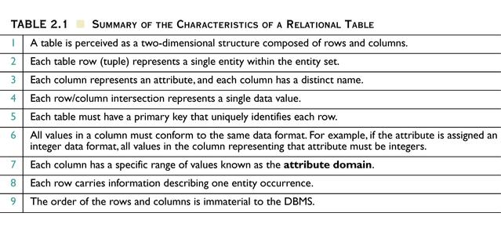
Summary of the Characteristics of a Relational Table
Table 2.1

Slide 9
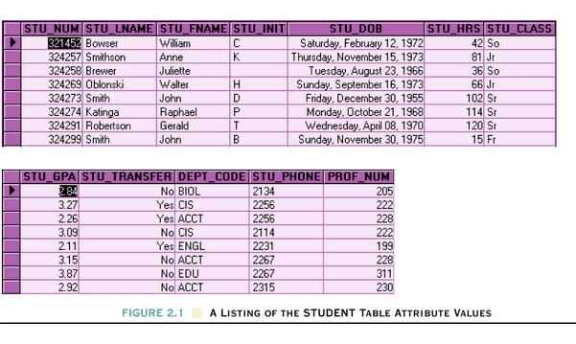
A Listing of the STUDENT Table Attribute Values
Figure 2.1

Slide 10
Keys
Controlled redundancy (shared common attributes) makes the relational database work.
The primary key of one table appears again as the link (foreign key) in another table.
If the foreign key contains either matching values or nulls, the table(s) that make use of such a foreign key are said to exhibit referential integrity.

Slide 11
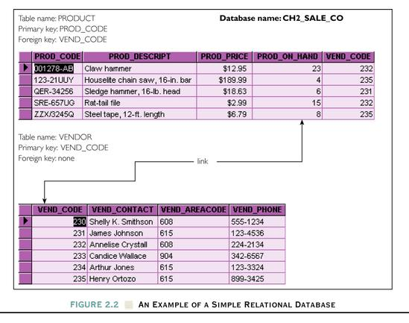
Figure 2.2 An Example of a Simple Relational Database

Slide 12
Keys
A key helps define entity relationships.
The key’s role is based on a concept known as determination, which is used in the definition of functional dependence.
The attribute B is functionally dependent on A if A determines B.
An attribute that is part of a key is known as a key attribute.
A multi-attribute key is known as a composite key.
If the attribute (B) is functionally dependent on a composite key (A) but not on any subset of that composite key, the attribute (B) is fully functionally dependent on (A).

Slide 13
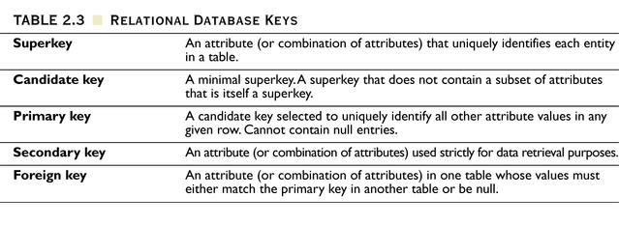
Relational Database Keys
Table 2.3

Slide 14
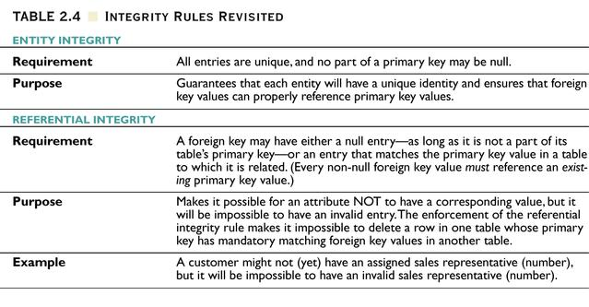
Integrity Rules Revisited
Table 2.4

Slide 15
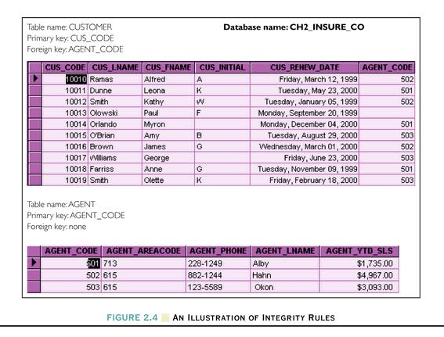
Figure 2.4 An Illustration of Integrity Rules

Slide 16
Relational Database Operators
The degree of relational completeness can be defined by the extent to which relational algebra is supported.
Relational algebra defines the theoretical way of manipulating table contents using the eight relational functions: SELECT, PROJECT, JOIN, INTERSECT, UNION, DIFFERENCE, PRODUCT, and DIVIDE.

Slide 17
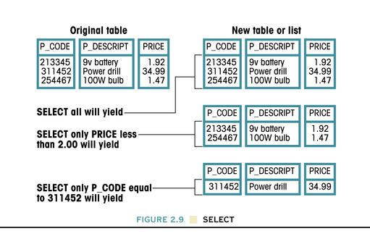
Relational Database Operators
SELECT yields values for all attributes found in a table. It yields a horizontal subset of a table.
(S)
σ (S)
σ_{price<2.00} (S)
σ_{p_code=311652} (S)

Slide 18
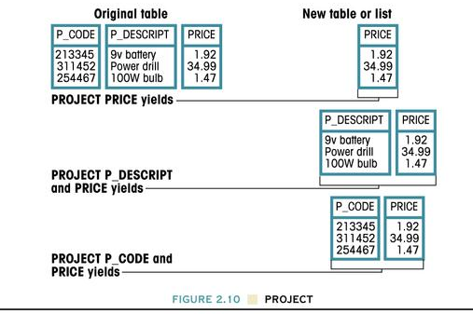
Relational Database Operators
PROJECT (π) produces a list of all values for selected attributes. It yields a vertical subset of a table.
(S)
π_{price} (S)
π_{p_descript,} _{price} (S)
π_{price(}σ_{p_code=213345} (S))

Slide 19
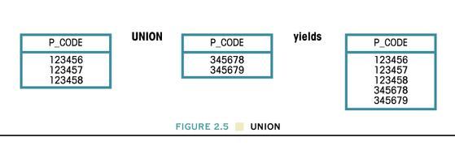
Relational Database Operators
UNION combines all rows from two tables. The two tables must be union compatible.
(R)
(S)
S U R
Figure 2.5 UNION

Slide 20
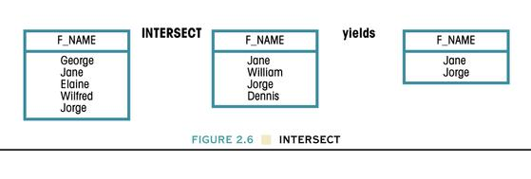
Relational Database Operators
INTERSECT produces a listing that contains only the rows that appear in both tables. The two tables must be union compatible.
S ∩ R
(R)
(S)
Figure 2.6 INTERSECT

Slide 21
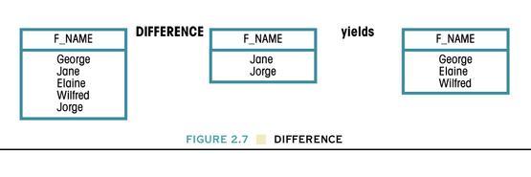
Relational Database Operators
DIFFERENCE yields all rows in one table that are not found in the other table; i.e., it subtracts one table from the other. The tables must be union compatible.
(R)
S - R
(S)
Figure 2.7 DIFFERENCE

Slide 22
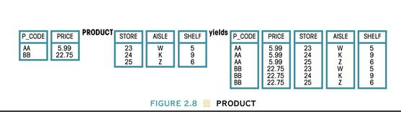
Relational Database Operators
PRODUCT produces a list of all possible pairs of rows from two tables.
(S)
(R)
S × R
Figure 2.8 PRODUCT

Slide 23
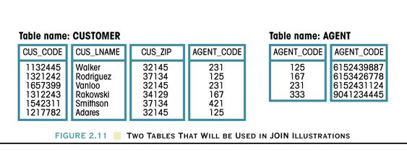
Relational Database Operators
JOIN allows us to combine information from two or more tables. JOIN is the real power behind the relational database, allowing the use of independent tables linked by common attributes.
(S)
(R)

Slide 24
Relational Database Operators
Natural JOIN links tables by selecting only the rows with common values in their common attribute(s). It is the result of a three-stage process:
A PRODUCT of the tables is created. (Figure 2.12)
A SELECT is performed on the output of the first step to yield only the rows for which the common attribute values match. (Figure 2.13)
A PROJECT is performed to yield a single copy of each attribute, thereby eliminating the duplicate column. (Figure 2.14)

Slide 25
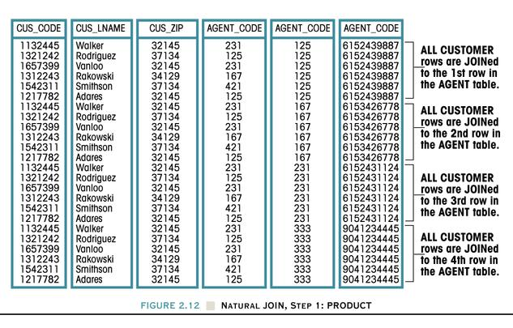
Natural Join, Step 1: PRODUCT
(S)
(R)
Figure 2.12

Slide 26
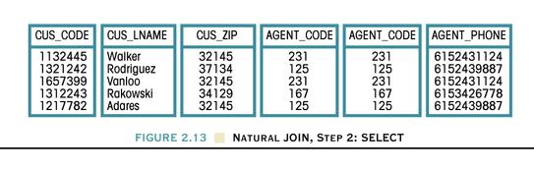
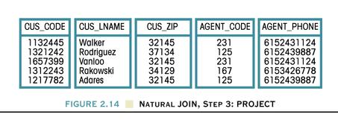
Figure 2.13 Natural Join, Step 2: SELECT
Figure 2.14 Natural Join, Step 3: PROJECT
S R

Slide 27
Relational Database Operators
EquiJOIN links tables based on an equality condition that compares specified columns of each table. The outcome of the EquiJOIN does not eliminate duplicate columns and the condition or criteria to join the tables must be explicitly defined.
Theta JOIN is an equiJOIN that compares specified columns of each table using a comparison operator other than the equality comparison operator.
In an Outer JOIN, the unmatched pairs would be retained and the values for the unmatched other tables would be left blank or null.

Slide 28
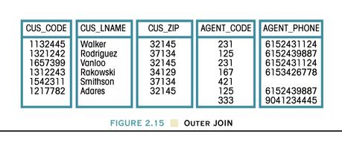
Outer JOIN
Figure 2.15

Slide 29
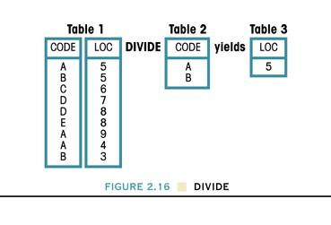
Relational Database Operators
DIVIDE requires the use of one single-column table and one two-column table.
Figure 2.16 DIVIDE

Slide 30
The Data Dictionary and the System Catalog
Data dictionary contains metadata to provide detailed accounting of all tables within the database.
System catalog is a very detailed system data dictionary that describes all objects within the database.
System catalog is a system-created database whose tables store the database characteristics and contents.
System catalog tables can be queried just like any other tables.
System catalog automatically produces database documentation.

Slide 31
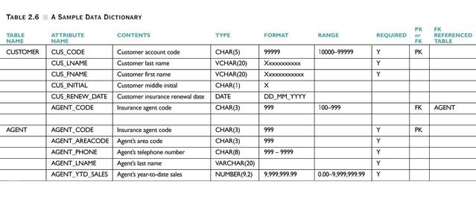
A Sample Data Dictionary
Table 2.6

Slide 32
Relational Algebra: 5 Basic Operations
Selection ( σ ) Selects a subset of rows from relation
(horizontal).
Projection ( π ) Retains only wanted columns from relation (vertical).
Cross-product ( × ) Allows us to combine two relations.
Set-difference ( — ) Tuples in r1, but not in r2.
Union ( ∪ ) Tuples in r1 or in r2.

Slide 33
Example Instances
R1
S1
Boats
S2

Slide 34
Projection (π)
Examples: ;
Retains only attributes that are in the “projection list”.
Schema of result:
exactly the fields in the projection list, with the same names that they had in the input relation.
Projection operator has to eliminate duplicates (How do they arise? Why remove them?)
Note: real systems typically don’t do duplicate elimination unless the user explicitly asks for it. (Why not?)

Slide 35
Projection (π)
sname
rating
yuppy
9
lubber
8
guppy
5
rusty
10
S2

Slide 36
Selection (σ)
Selects rows that satisfy selection condition.
Result is a relation.
Schema of result is same as that of the input relation.
Do we need to do duplicate elimination?
sid
sname
rating
age
28
yuppy
9
35.0
sname
rating
31
lubber
8
55.5
yuppy
9
44
guppy
5
35.0
58
rusty
10
35.0
rusty
10

Slide 37
Union and Set-Difference
Both of these operations take two input relations, which must be union-compatible:
Same number of fields.
`Corresponding’ fields have the same type.
For which, if any, is duplicate elimination required?

Slide 38
Union
S1
S2

Slide 39
Set Difference
S1
S2 – S1
S2

Slide 40
Cross-Product
S1 × R1: Each row of S1 paired with each row of R1.
Q: How many rows in the result?
Result schema has one field per field of S1 and R1, with field names `inherited’ if possible.
May have a naming conflict: Both S1 and R1 have a field with the same name.
In this case, can use the renaming operator:

Slide 41
Cross Product Example
R1
S1
S1 x R1 =

Slide 42
Compound Operator: Intersection
In addition to the 5 basic operators, there are several additional “Compound Operators”
These add no computational power to the language, but are useful shorthands.
Can be expressed solely with the basic ops.
Intersection takes two input relations, which must be union-compatible.
Q: How to express it using basic operators?
R ∩ S = R − (R − S)

Slide 43
Natural Join Example
R1
S1
S1 R1 =

Slide 44
Other Types of Joins
Condition Join (or “theta-join”):
Result schema same as that of cross-product.
May have fewer tuples than cross-product.
Equi-Join: Special case: condition c contains only conjunction of equalities.
(
sid)
sname
rating
age
(
sid)
bid
day
22
dustin
7
45.0
58
103
11/12/96
31
lubber
8
55.5
58
103
11/12/96

Slide 45
Examples
Reserves
Sailors
Boats

Slide 46
Find names of sailors who’ve reserved boat #103
Solution 1:
Solution 2:

Slide 47
Find names of sailors who’ve reserved a red boat
Information about boat color only available in Boats; so need an extra join:
A more efficient solution:
A query optimizer can find this given the first solution!

Slide 48
Find sailors who’ve reserved a red boat or a green boat
Can identify all red or green boats, then find sailors who’ve reserved one of these boats:

Slide 49
Find sailors who’ve reserved a red and a green boat
Cut-and-paste previous slide?

Slide 50
Find sailors who’ve reserved a red and a green boat
Previous approach won’t work! Must identify sailors who’ve reserved red boats, sailors who’ve reserved green boats, then find the intersection (note that sid is a key for Sailors):

Slide 51
Summary
Relational Algebra: a small set of operators mapping relations to relations
Operational, in the sense that you specify the explicit order of operations
A closed set of operators! Can mix and match.
Basic ops include: σ, π, ×, ∪, —
Important compound ops: ∩, ,

